Slide 1
Power Monitor - Hardware
Pak Lam (Jack) Yung

Slide 2
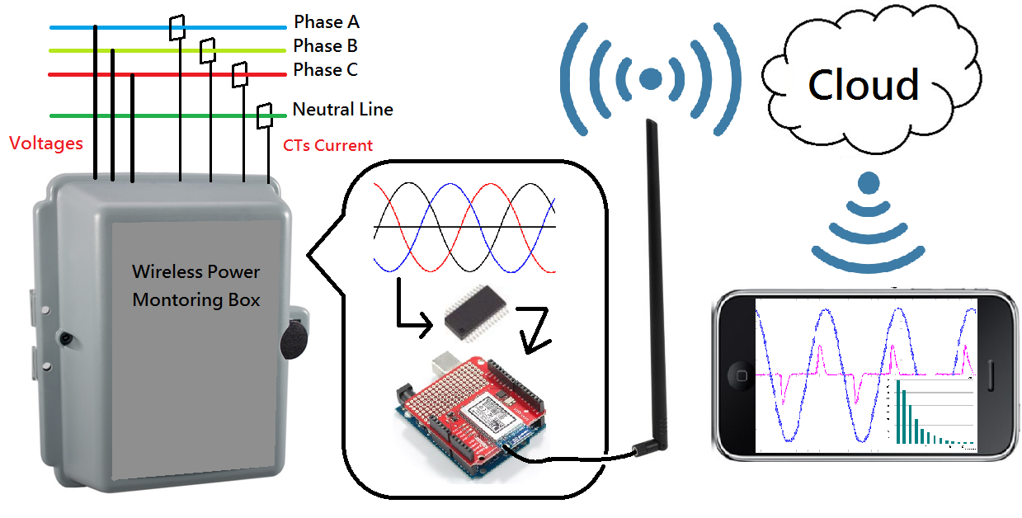
Power Monitoring System

Slide 3
Hardware Design
PCB Design (2x)
Packaging
Testing
Installation

Slide 4
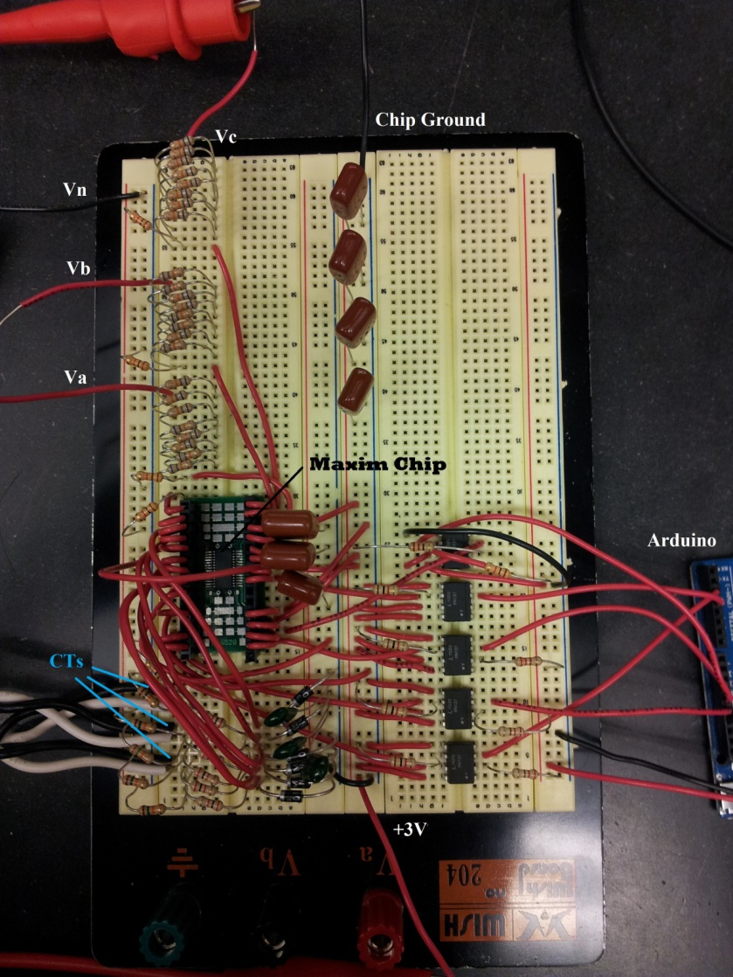
One Year Ago

Slide 5
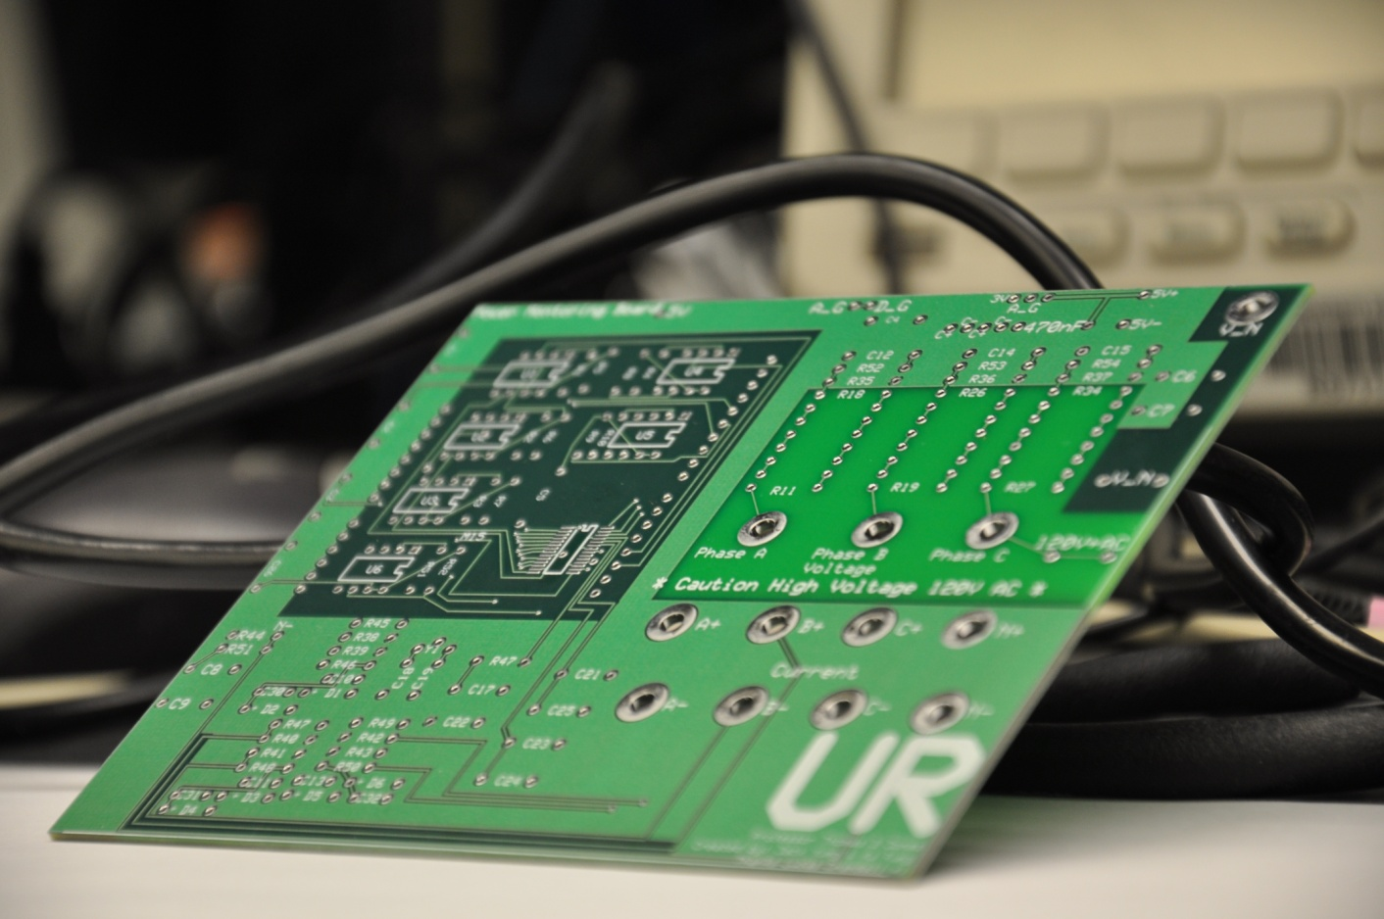
Summer 2012

Slide 6
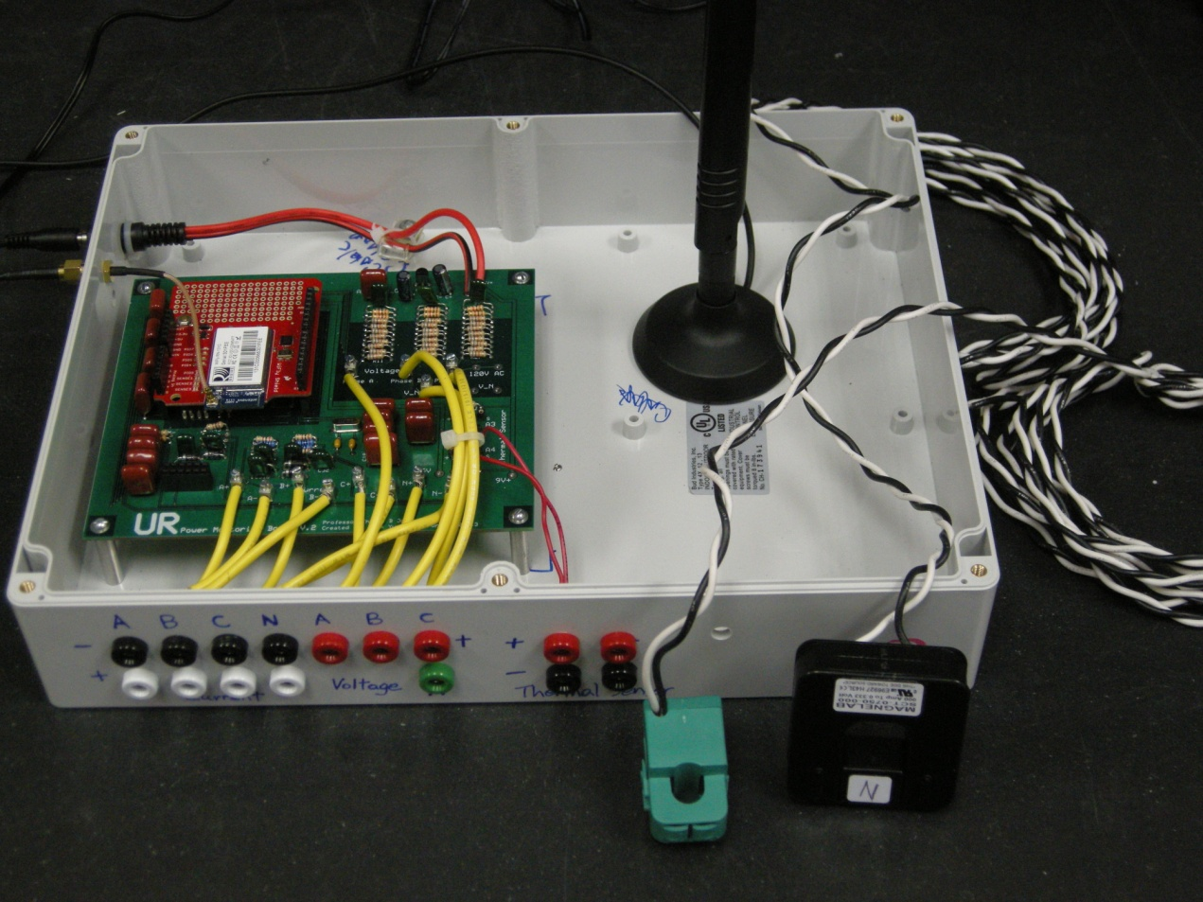
Spring 2013

Slide 7
First Circuit
Noise
Not safe
Unstable
Cheap

Slide 8
First PCB
Low Noise
Safe
4 layer
$219.9 – 4 piece
$55 per piece
Order from express PCB (Free Software)
http://www.expresspcb.com/

Slide 9
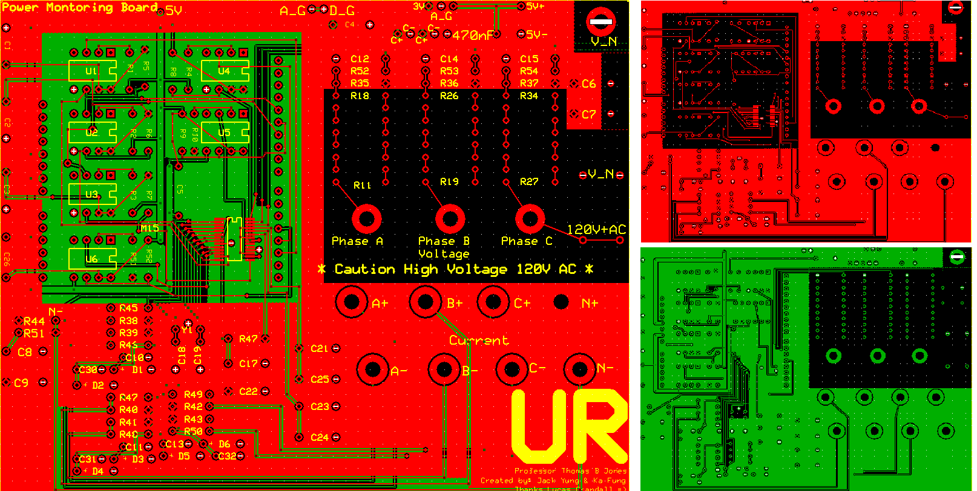
4 layer PCB

Slide 10
4 Layer
Top: N+
2nd: Digital Ground
3rd: Analog Ground
Bottom: ~3V

Slide 11
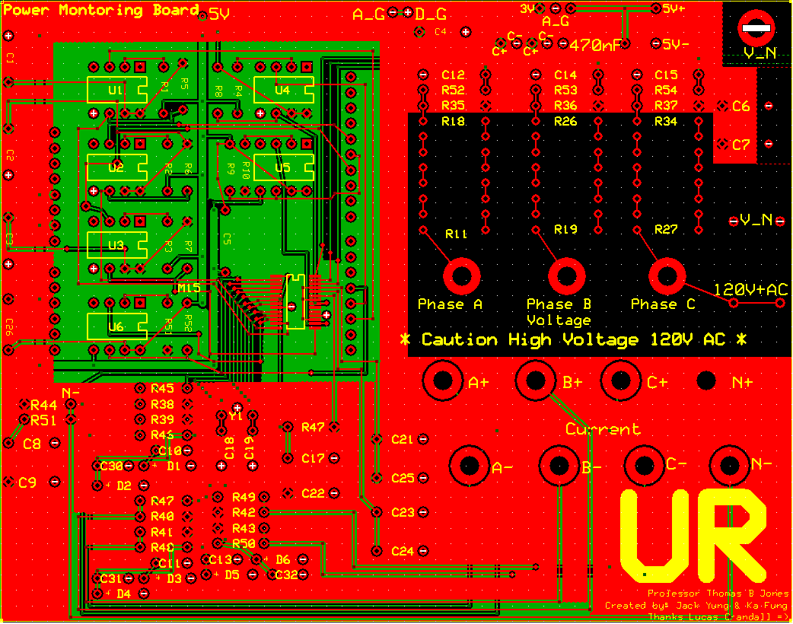
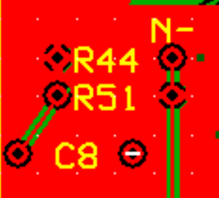
One Mistake for the first PCB
R51 Right Hole
should Not connect
to top layer (N+)

Slide 12
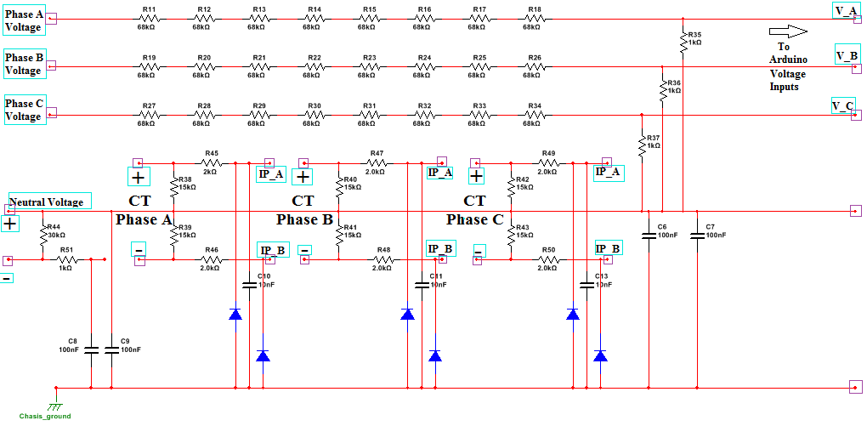
Circuit

Slide 13
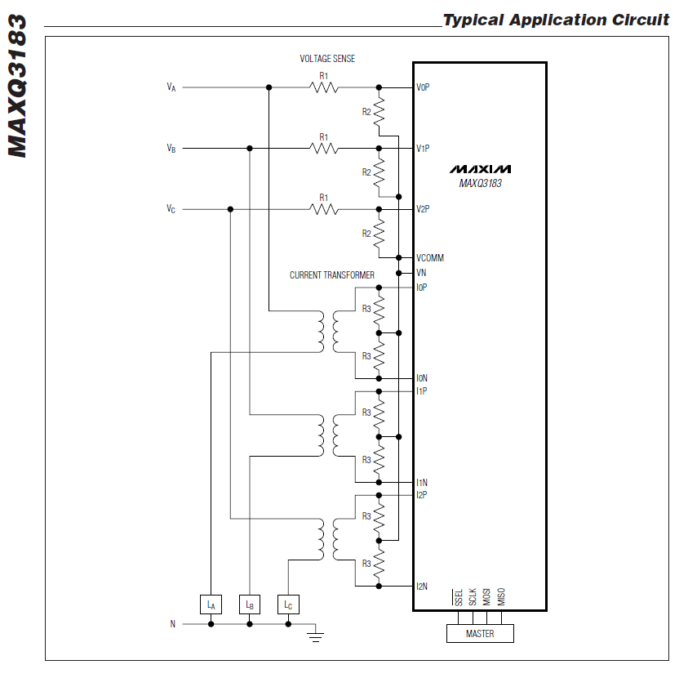
Circuit

Slide 14
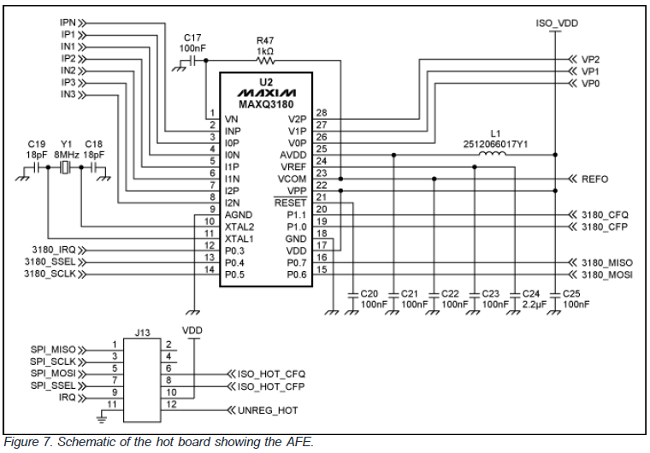
Circuit

Slide 15
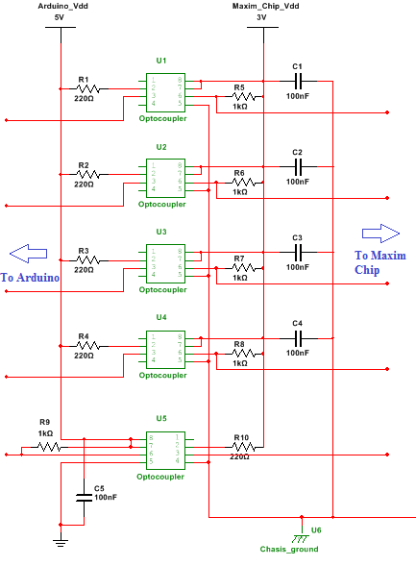
Circuit

Slide 16
Component
Arduino Uno Board
Wifly Shield
CT
Resistors, Capacitor
Optopcoupler
Maxim Chip
Stackable Header
Crystal Oscillator
Voltage Regulator 5v to 3v
Transformer AC to DC

Slide 17
Where to Buy Them ?!
http://www.sparkfun.com/products/10007
https://shop.maximintegrated.com/storefront/priceavailable.do?Partnumber=MAXQ3183-RAN%252B&event=PartSearch&menuitem=PriceAndAvailability#
http://www.digikey.com/product-detail/en/6N137/160-1791-ND/1969175
http://www.digikey.com/product-detail/en/EPS090066-P5P/T980-P5P-ND/1016856
http://www.digikey.com/product-detail/en/LP2950-33LPRE3/296-31455-1-ND/3505910
http://www.newegg.com/Product/Product.aspx?Item=N82E16833998117
https://www.sparkfun.com/products/9954

Slide 18
PCB 2
Same components
BUT used Arduino Mage and added Thermal Sensor
Bigger size
Still 4 layer, circuit design is about the same.
6 piece for $430.99
Each board is 72
Express PCB

Slide 19
Circuit Power
120 AC to 9v and 5v DC
9v Goes to Anduino, 5v goes to regulator and change to 3v.
3V power the chip and Optopcoupler

Slide 20
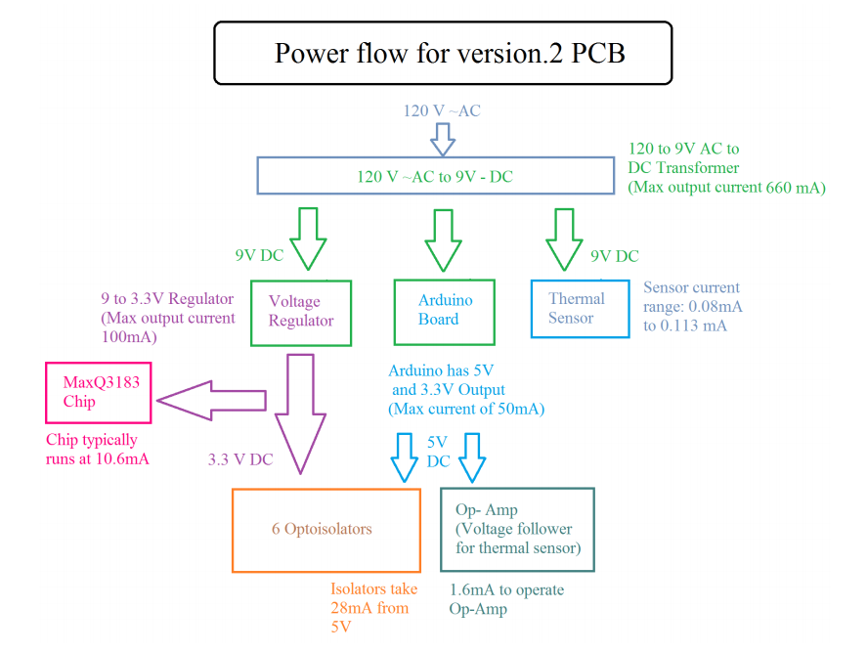
Circuit Power

Slide 21
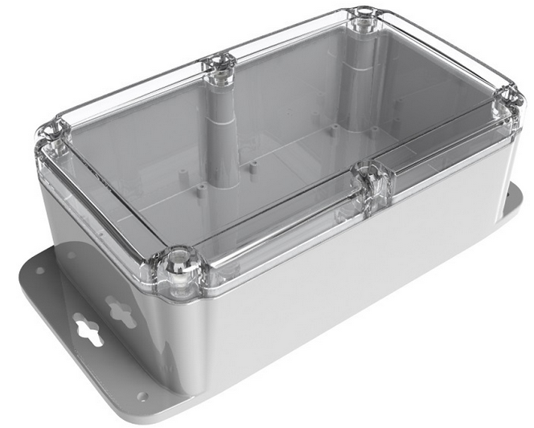
Packaging
Size measurement, purchase, installation

Slide 22
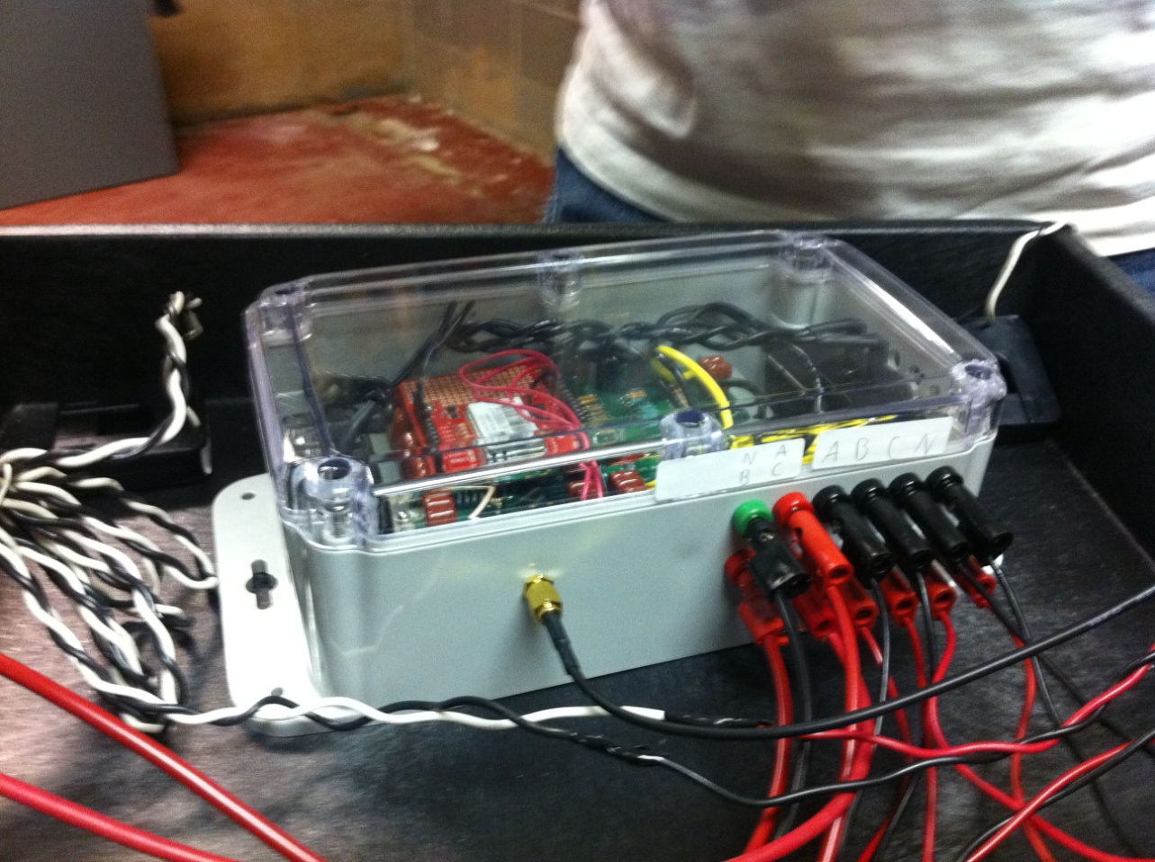
Box 1 – Hopeman Building

Slide 23
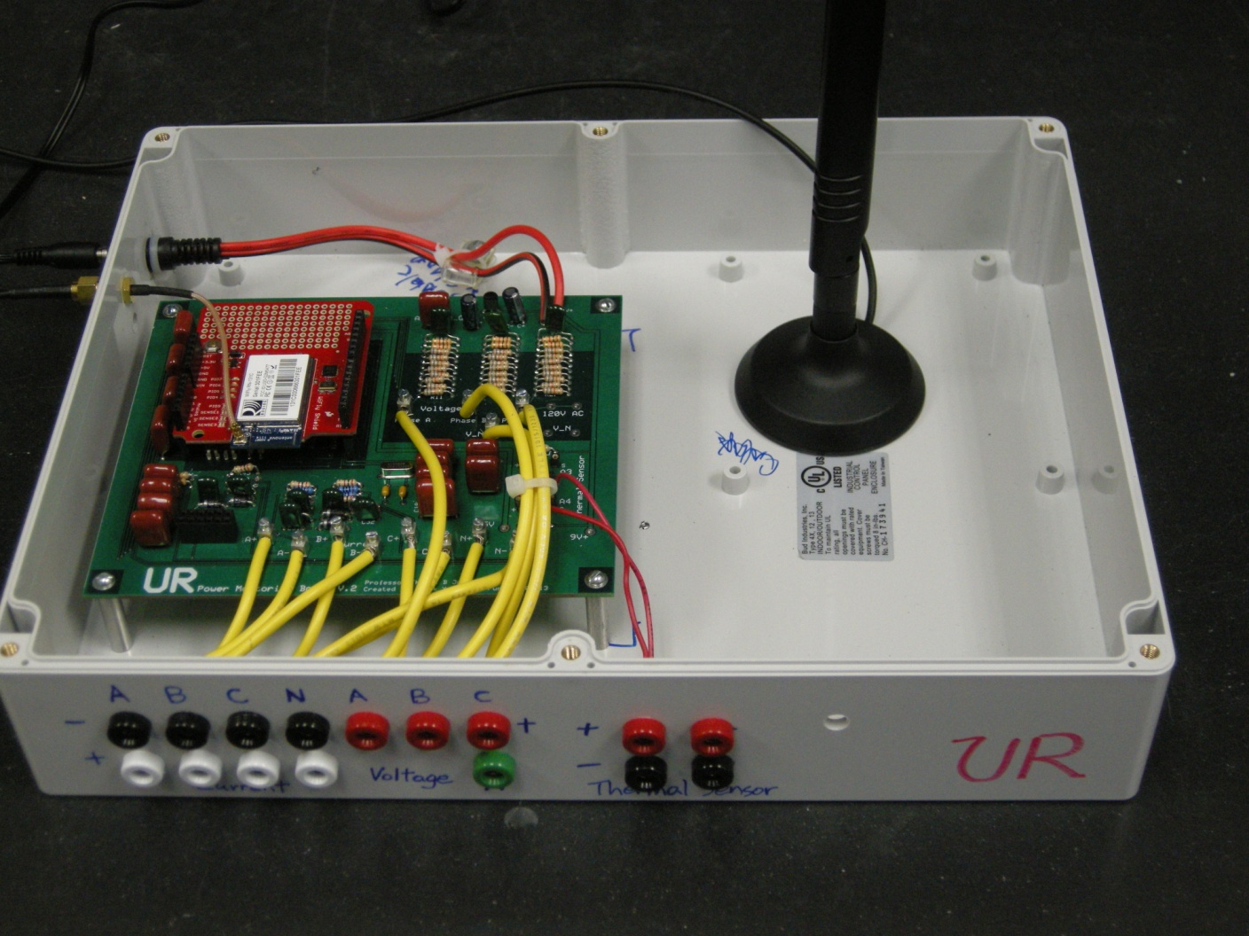
Box 2

Slide 24
Testing
After building and soldering the board, run the sample code, get same reading. Let it run in the lab for few days and make sure it is safe to use (High voltage !!!)

Slide 25
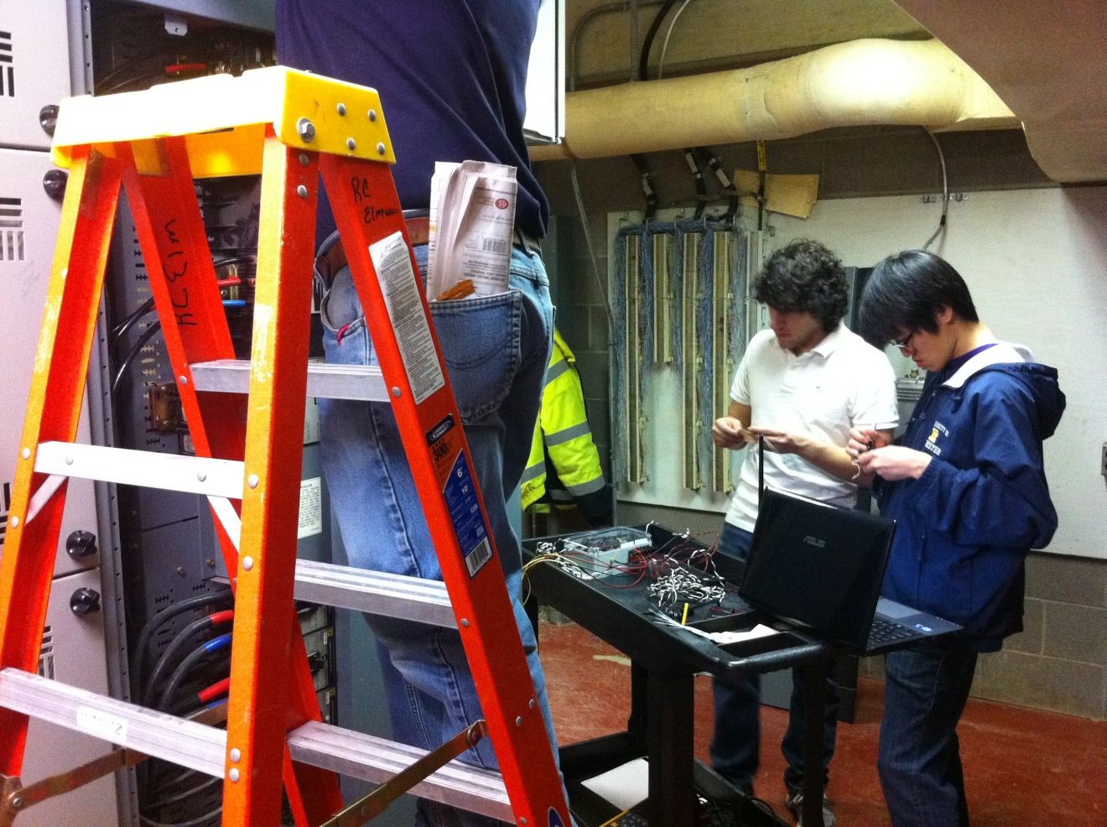
Installation

Slide 26
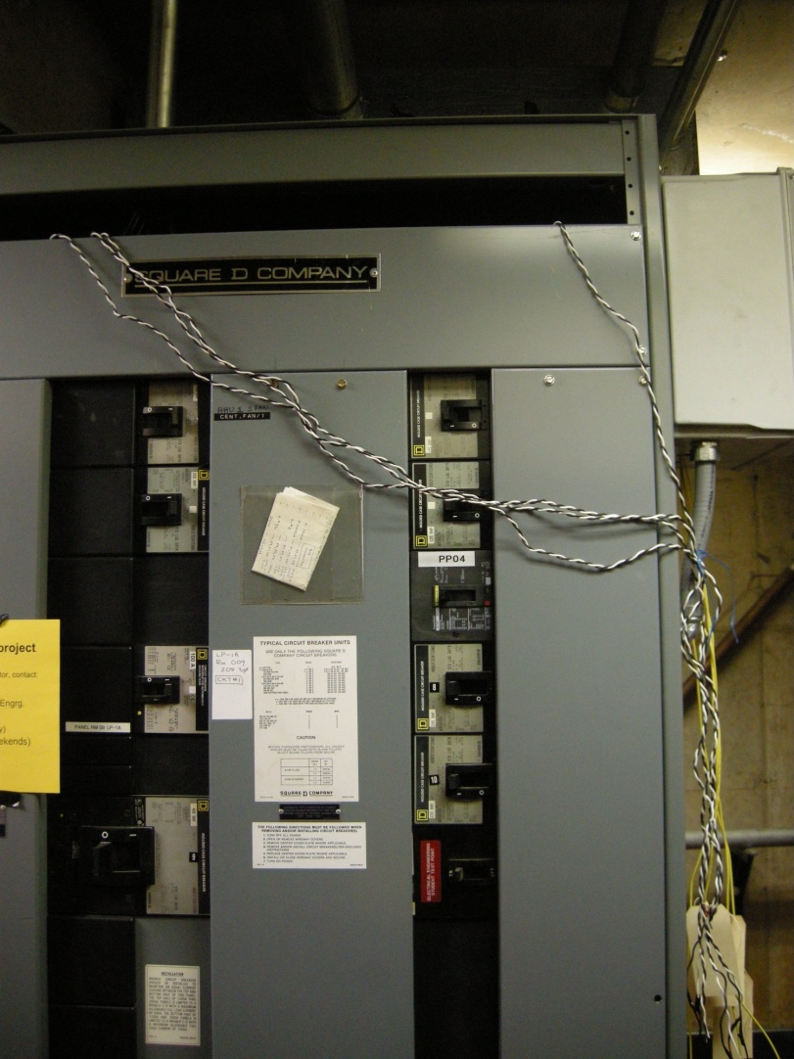
Installation

Slide 27
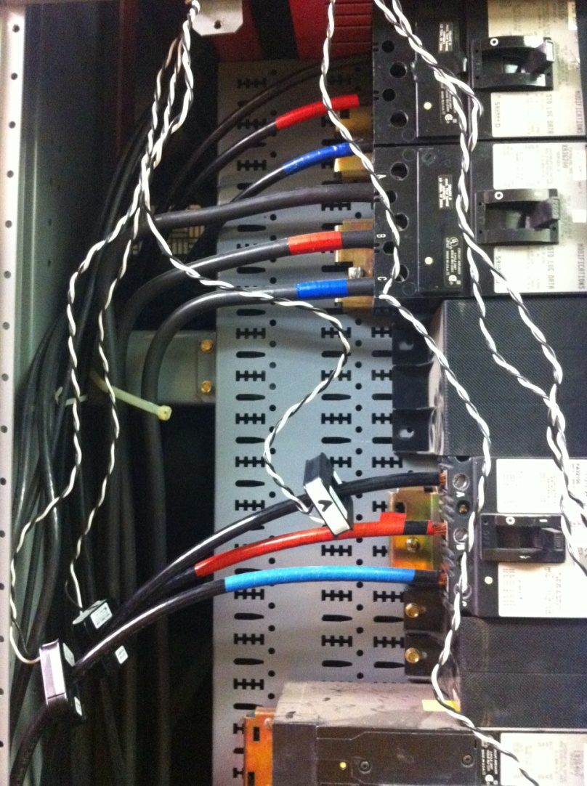
Installation

Slide 28
Inventory
Arduino Uno Board X3
Arduino Mage x1
PCB V1 x2
PCB v2 x5 (un soldered)
Wifly Shield X2
CT x 9
Resistors, Capacitor (Workshop)
Optopcoupler x24
Maxim Chip x5
Stackable Header x6 sets
Crystal Oscillator x4
Voltage Regulator x5
Transformer AC to 9 DC x3
Box x2 (1 big and 1 small)
Antenna x2
Laptop x1

